Slide 1
CSE 12 – Basic Data Structures and Object-Oriented Design Lecture 13
Greg Miranda and Paul Cao, Winter 2021
This lecture is being recorded

Slide 2
Announcements
Quiz 13 due Monday @ 8am
Survey 5 due tonight @ 11:59pm
PA5 due Wednesday @ 11:59pm

Slide 3
Topics
Partition/Sort
Questions on Lecture 13?

Slide 4
public class SortFast {
public static String s(int[] arr) { return Arrays.toString(arr); }
public static int[] combine(int[] part1, int[] part2) {
int index1 = 0, index2 = 0;
int[] combined = new int[part1.length + part2.length];
while(index1 < part1.length && index2 < part2.length) {
if(part1[index1] < part2[index2]) {
combined[index1 + index2] = part1[index1];
index1 += 1;
}
else {
combined[index1 + index2] = part2[index2];
index2 += 1;
}
}
while(index1 < part1.length) {
combined[index1 + index2] = part1[index1]; index1 += 1;
}
while(index2 < part2.length) {
combined[index1 + index2] = part2[index2]; index2 += 1;
}
System.out.println(s(part1) + " + " + s(part2) + " -> " + s(combined));
return combined;
}
public static int[] sortC(int[] arr) {
if(arr.length <= 1) { return arr; }
else {
int[] part1 = Arrays.copyOfRange(arr, 0, arr.length / 2);
int[] part2 = Arrays.copyOfRange(arr, arr.length / 2, arr.length);
System.out.println(s(arr) + " -> " + s(part1) + " + " + s(part2));
int[] sortedPart1 = sortC(part1);
int[] sortedPart2 = sortC(part2);
int[] sorted = combine(sortedPart1, sortedPart2);
return sorted;
}}}
public static void main(String[] args) {
int[] result = SortFast.sortC(new int[]{34, 93, 12, 49, 69, 25, 39 });
System.out.println(SortFast.s(result));}

Slide 5
Quicksort: Another magical (recursive) algorithm
https://www.youtube.com/watch?v=ywWBy6J5gz8
14
4
9
12
15
8
19
2
Select a pivot element:
14
4
9
12
15
8
19
2
“Partition” the elements in the array (smaller or equal to pivot, larger or equal to pivot)
2
4
9
8
15
12
19
14
Magically sort the smaller elements and the larger elements (Quicksort)
2
4
8
9
12
15
19
21

Slide 6
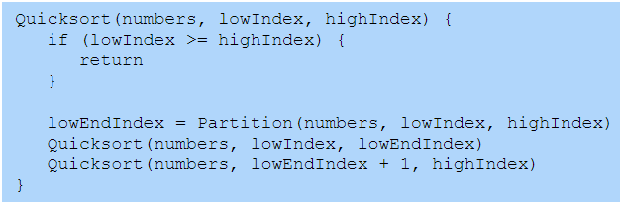
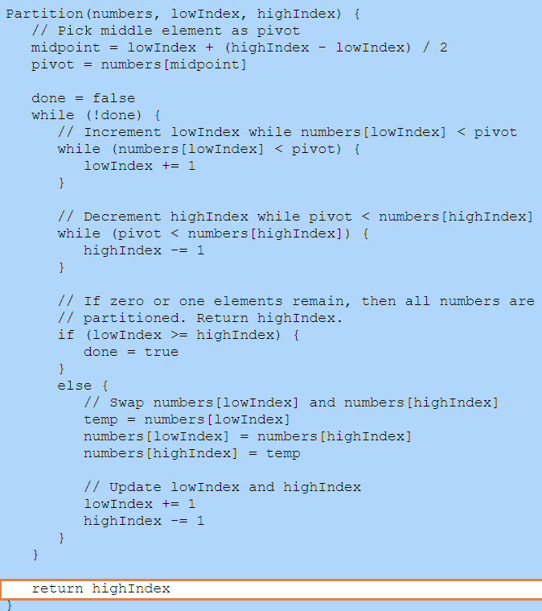
There are many ways to partition!

Slide 7
Quick sort
sort {12, 4, 9, 3, 15, 8, 19, 2}

Slide 8
Quick Sort Details
We always pick the middle location as pivot
The data we sort is {2, 3, 1, 5, 4, 6, 7}
After the first split, what is the order of elements in the list that was <= pivot?
1 2 3 4
2 3 1 4
4 3 2 1
3 4 1 2
None of the above

Slide 9
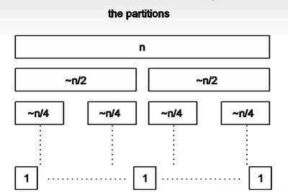
Quick Sort: Using a “good” pivot
How many levels will there be if you choose a pivot that divides the list in half?
1
log(N)
N
N*log(N)
N²

Slide 10
Quick Sort: Using a “good” pivot
If the time to partition on each level takes N comparisons, how long does Quicksort take with a good partition?
O(1)
O(log(N))
O(N)
O(N*log(N))
O(N²)

Slide 11
Which of these choices would be the worst choice for the pivot?
The minimum element in the list
The last element in the list
The first element in the list
A random element in the list

Slide 12
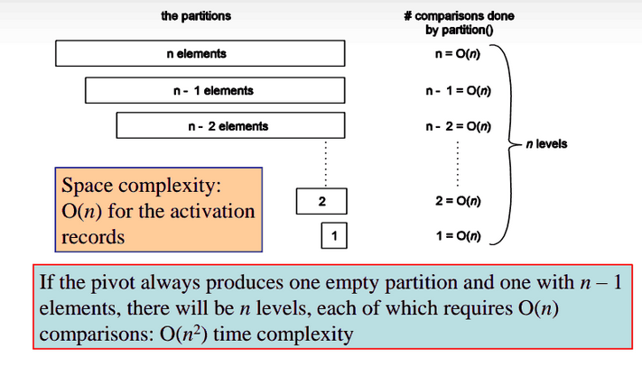
Quick sort with a bad pivot

Slide 13
Which of these choices is a better choice for the pivot?
The first element in the list
A random element in the list
They are about the same

Slide 14
public class Sort {
public static void swap(String[] array, int i1, int i2) {
String temp = array[i1];
array[i1] = array[i2];
array[i2] = temp;
}
public static int partition(String[] array, int low, int high) {
int pivotStartIndex = high - 1;
String pivot = array[pivotStartIndex];
int smallerBefore = low, largerAfter = high - 2;
while (smallerBefore <= largerAfter) {
if (array[smallerBefore].compareTo(pivot) < 0) {
smallerBefore += 1;
}
else {
swap(array, smallerBefore, largerAfter);
largerAfter -= 1;
}
}
swap(array, smallerBefore, pivotStartIndex);
return smallerBefore;
}
public static void qsort(String[] array, int low, int high) {
if (high - low <= 1) { return; }
int splitAt = partition(array, low, high);
qsort(array, low, splitAt);
qsort(array, splitAt + 1, high);
}
public static void sort(String[] array) {
qsort(array, 0, array.length);
}
main() {
String[] str = {"f", "b", "a", "e", "d", "c" };
int[] result = Sort.sort(str);
System.out.println(Arrays.deepToString(result));
}

